Slide 1
Inorganic Chemistry
Introduction; Chapter 2
CHEM 4610/5560
University of North Texas
Fall 2008

Slide 3
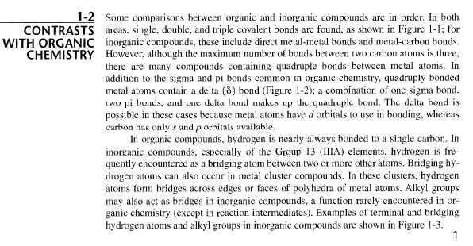

Slide 5
Structure of the Atom
Composed of:
Protons
Neutrons
Electrons
Protons
  Found in the nucleus
  Relative charge: +1 each
  Relative mass: 1.0073 amu each
Neutrons
  Found in the nucleus
  Neutral charge
  Relative mass: 1.0087 amu each
Electrons
  Found in a cloud outside the nucleus
  Relative charge: -1 each
  Relative mass: 0.00055 amu each (almost negligible vs. proton or neutron)

Slide 6
Atomic Number; Mass Number; Isotopes
Atomic number, Z
  the number of protons in the nucleus
  the number of electrons in a neutral atom
  the integer on the periodic table for each element
Mass Number, A
  integer representing the approximate mass of an atom
  equal to the sum of the number of protons and neutrons in the nucleus
Isotopes
  atoms of the same element which differ in the number of neutrons in the nucleus
  designated by mass number
Nuclear Notation
A
E
Z

Slide 7
Isotopes vs. Allotropes
Isotopes - atoms of the same element with different numbers of neutrons
Allotropes - different forms of an element
e.g., Carbon exhibits both
Isotopes: C-12 C-13 C-14
Allotropes: graphite, diamond, and fullerenes

Slide 8
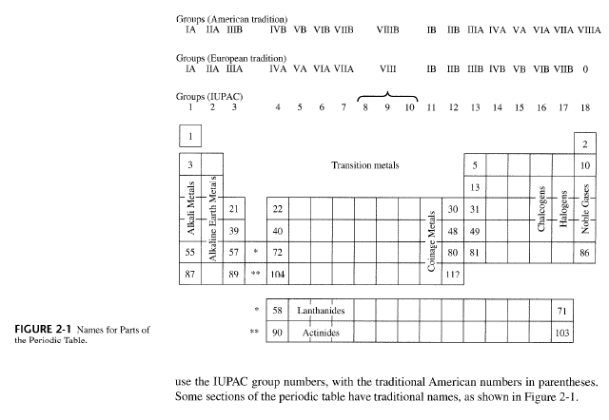
Periodic Table of the Elements

Slide 9
Classification of the Elements
Metals
Lustrous, malleable, ductile, electrically conducting solids at room temperature
Nonmetals
Often gases, liquids, or solids that do not conduct electricity appreciably

Slide 10
Classification of the Elements
Metallic elements combine with nonmetallic elements to give compounds that are typically hard, non-volatile solids (usually ionic compounds)
When combined with each other, the nonmetals often form volatile molecular compounds
When metals combine (or simply mix together) they produce alloys that have most of the physical characteristics of metals

Slide 11
Periodic Table of the Elements
Many web sites have periodic tables like this
A particularly useful resource: www.webelements.com

Slide 12


= (1/λ) = wavenumber
Correct the book
Page18

Slide 13
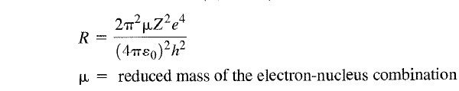
Hydrogenic Energy Levels
hcZ²R
E = - -----------
n²
where n = 1, 2, 3, hhh
R = Rydberg constant
Value varies by element
For hydrogen, R_{H} = 1.097 X 10⁷ m⁻¹

Slide 14
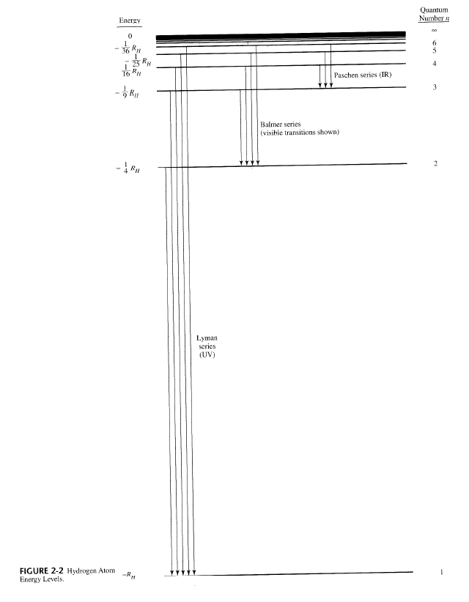
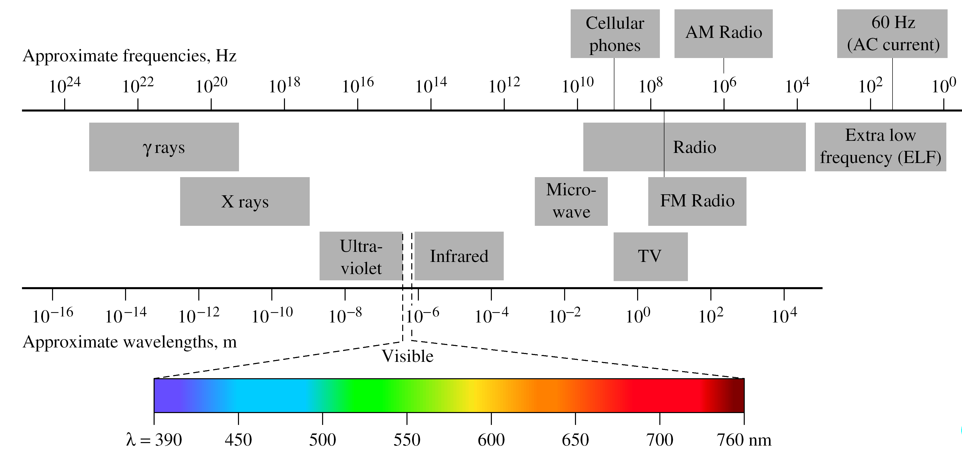
The Electromagnetic
Spectrum

Slide 15

The Electromagnetic Spectrum
UV, X rays are shorter wavelength, higher frequency radiation.
Communications involve longer wavelength, lower frequency radiation.
Visible light is only a tiny portion of the spectrum.

Slide 16
Example:
Calculate the wavenumber (cm⁻¹), wavelength (nm), and energy (J) for:
the lowest-energy transition in the Paschen series of the hydrogen spectrum?
the second- lowest-energy transition in the Balmer series of the hydrogen spectrum?
the longest-wavelength transition in the Lyman series of the hydrogen spectrum?

Slide 17
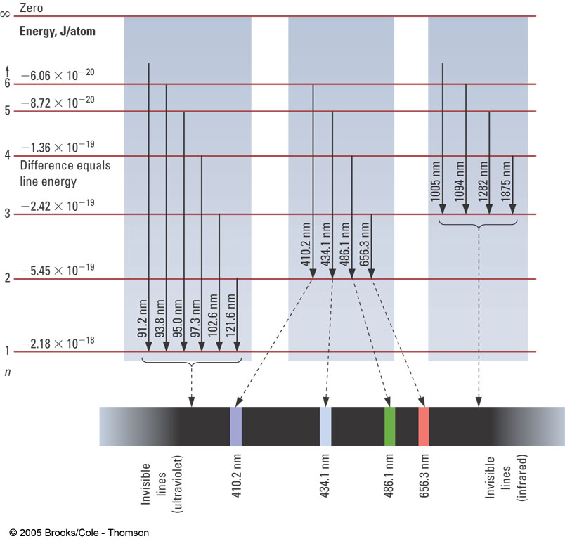
Solution for part b) only; practice a) and c); check all answers on the spreadsheet on the course web site
b) second- lowest-energy transition in the Balmer series➔ n_{l} =2; n_{h} = 4
=
= (1.097 X 10⁷ m⁻¹ ) ( 1/4 -1/16 )
= 2.057 X 10⁶ m⁻¹ = 2.057 X 10⁴ cm⁻¹
λ = 1/ = 1/(2.057 X 10⁶ m⁻¹) = 486.2 nm
➔consistent w/ Balmer series (visible region)
E = hc =
(6.626 X 10⁻³⁴ Js) (2.997 X 10⁸ m/s) (2.057 X 10⁶ m⁻¹)
= 4.086 X 10⁻¹⁹ J

Slide 18
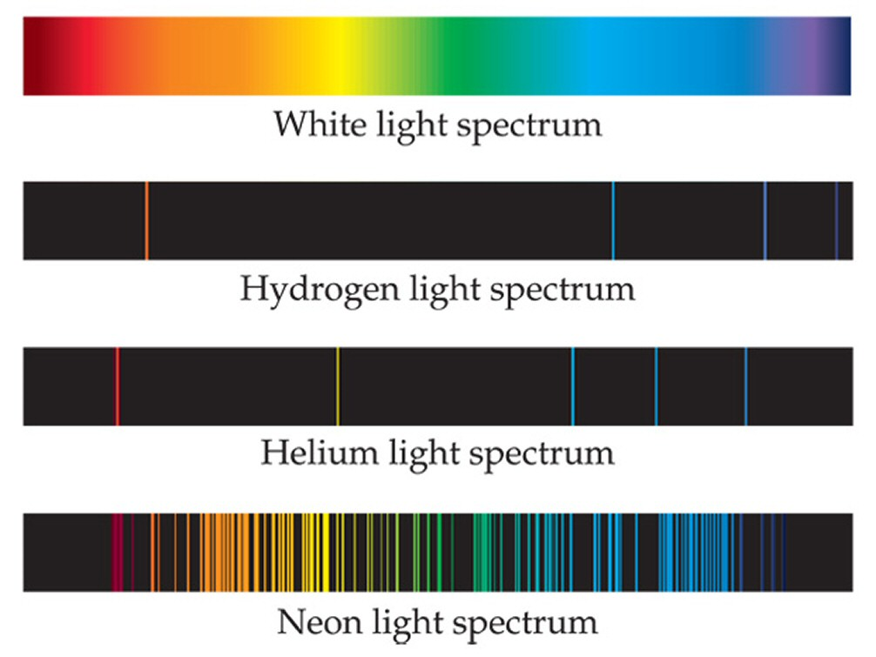
Atoms and Energy
  Absorbed Energy Re-emitted as Light
  Atoms Emit Unique Spectra – Color
Emission Spectrum
  Light Emitted by Glowing Elemental Gas
  Elements have Unique Emission Spectra Atomic emission
  Spectra Characteristic of Element
  spectrum of wavelengths can be used to identify the element

Slide 19
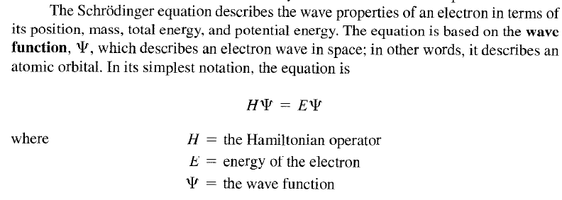
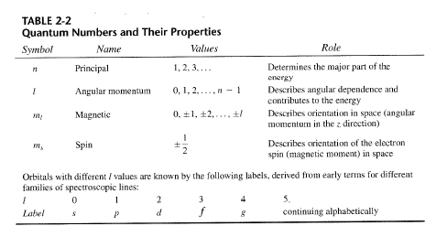
A quantum mechanics approach to determining the energy of electrons in an element or ion is based on the results obtained by solving the Schrödinger Wave Equation for the H-atom. The various solutions for the different energy states are characterized by the three quantum numbers, n, l and ml ( plus ms).

Slide 20
Quantum Mechanics
The Schrodinger Equation
Take
Math 1710
Math 1720
Math 2730
Math 3410
Math 3420
and
Solve
1. Quantum numbers
(n, ι , m_{ι} , m_{s})
2. The wavefunction (Ψ)
3. The energy (E)

Slide 21
Quantum Numbers
n → principal quantum number, quantized energy levels, which energy level
Electrons in an atom reside in shells characterised by a particular value of n
n = 1, 2, 3, 4, 5, 6, 7, etc.

Slide 22
Quantum Numbers
l → secondary quantum number, quantized orbital angular momentum, which sublevel or type of orbital
l = 0, 1, 2, 3, ... , (n-1),traditionally termed s, p, d, f, etc. orbitals.
Each orbital has a characteristic shape reflecting the motion of the electron in that particular orbital, this motion being characterized by an angular momentum that reflects the angular velocity of the electron moving in its orbital.
s type orbital l = 0
p type orbital l = 1
d type orbital l = 2
f type orbital l = 3
g type orbital l = 4

Slide 23
Quantum Numbers
m_{l} → magnetic quantum number, quantized orientation of angular momentum, which orbital within sublevel
m_{l} is a subset of l, where the allowable values are:
m_{l} = l, l-1, l-2, ..... 1, 0, -1, ....... , -(l-2), -(l-1), -l.
In other words,
m_{l} = 0, ±1, ± 2, ±3, ± l.
There are thus (2l +1) values of m_{l} for each l value,
i.e. one s orbital (l = 0), three p orbitals (l = 1), five d orbitals (l = 2),
s type orbital m_{l} = 0
p type orbital m_{l} = +1, 0 or -1
one value for each of the three p orbitals
d type orbital m_{l} = +2, +1, 0, -1 or -2
one value for each of the five d orbitals
f type orbital m_{l} = +3, +2, +1, 0, -1, -2 or -3
one value for each of the seven f orbitals

Slide 24
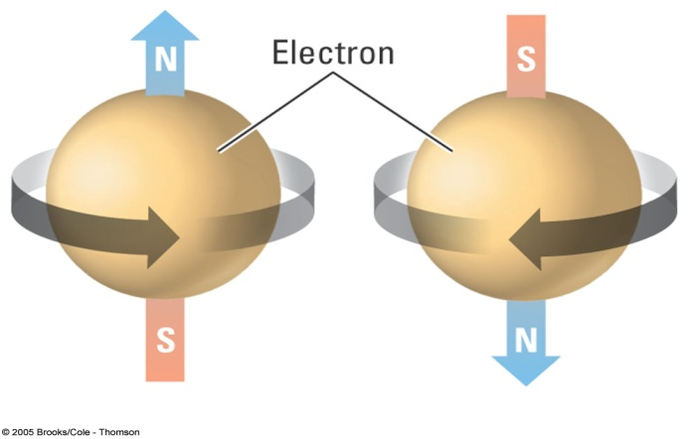
Quantum Numbers
m_{s} → identifies the orientation of the spin of one electron relative to those of other electrons in the system. A single electron in free space has a fundamental property associated with it called spin, arising from the spinning of an asymmetrical charge distribution about its own axis. Like an electron moving in its orbital around a nucleus, the electron spinning about its axis has associated with its motion a well defined angular momentum.
The value of m_{s} is either:
+ ½ (spin up) or - ½ (spin down)
m_{s} = +1/2 m_{s} = -1/2

Slide 25
The Quantum Numbers
1. n - The Principal Quantum Number
n = 1, 2, 3, ...
Determines Energy and size of orbital
2. l- (“el”) - The Azimuthal Quantum Number
l = 0, 1, 2, ..., n-1
Determines the number and
shapes of orbitals
Notation: l : 0 1 2 3
letter: s p d f
3. m_{l} - The Magnetic Quantum Number
m_{l} = -l, ..., 0 , 1, 2,..., +l or
m_{l} = 0, ±1 , ±2, ..., ±l
Determines the orientation of orbitals
4. m_{s} - The Spin Quantum Number
m_{s} = +1/2 , -1/2
Determines the spin direction of electron

Slide 26
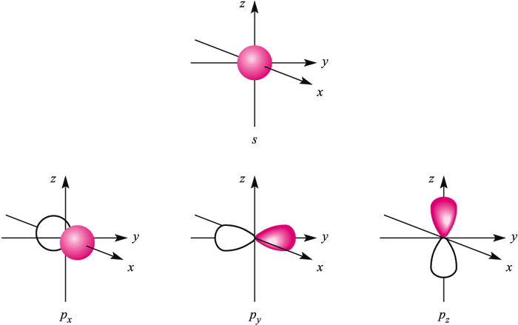
Shapes of s- and p- orbitals
-Electrons are distributed in atomic orbitals (AO’s)
Number of each orbital type in each shell:
s: _
p: _ _ _
d: _ _ _ _ _
f: _ _ _ _ _ _ _
s: spherical
p: dumb-bell across three axes (p_{x}, p_{y}, p_{z})

Slide 27
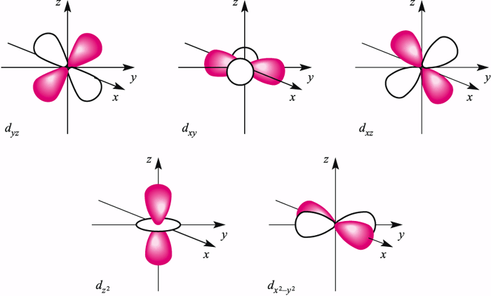
e-density between axes
d-orbitals
e-density on axes

Slide 28
f-orbitals
Seven

Slide 29
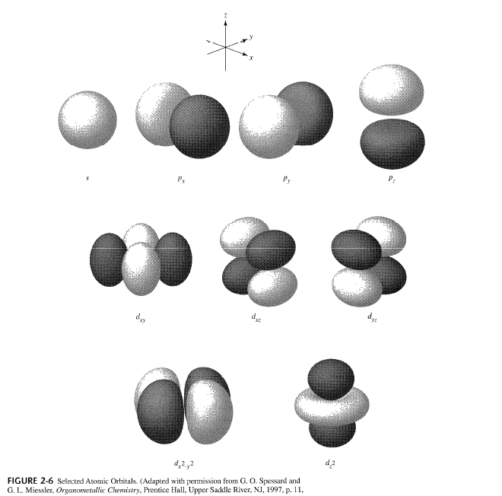

Slide 30
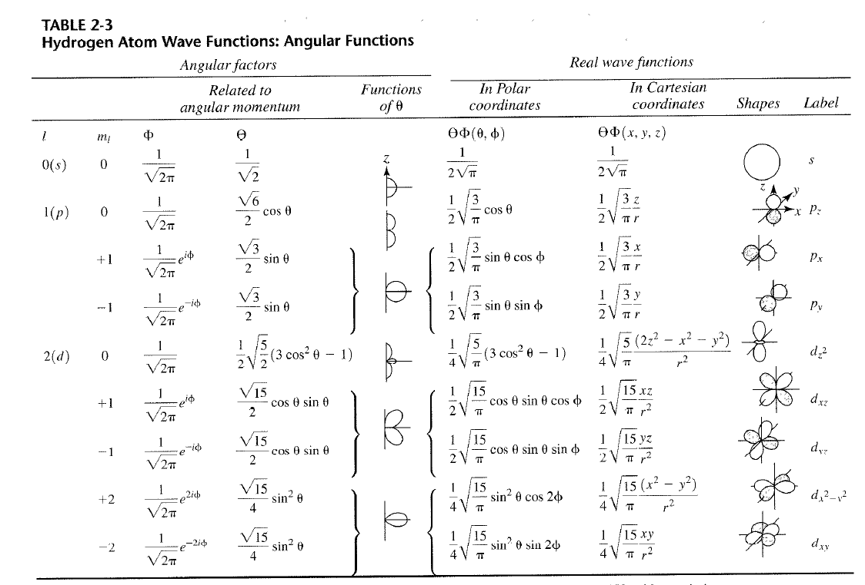
Just as an FYI; do not memorize!

Slide 31
“AUFBAU” = “building up”
Sets the rules for e-distribution in AO’s (holey grail = e-configuration!)
Three sub-principles/rules for the AUFBAU PRINCIPLE:
Pauli Exclusion Principle
No two electrons in an atom can have the
same 4 quantum numbers.
No more than 2 electrons can occupy a single orbital

Slide 32
___
___
(a)
___
___
(b)
Better definition:
Spin multiplicity = 2S+1
S = Σ m_{s}
Apply this definition to table & to the excited states (a)&(b) shown here:

Slide 33
Example,
Apply Pauli Exclusion Principle to all e’s in the n=3 shell
n=3 ➔ l = 0, 1, 2
3s, 3p, 3d
3s l = 0 → m_{l} = 0 → m_{s}= +1/2; -1/2
3p ➔ 6 e’s
Try 3d on your own
m_{l} +1 0 -1
e⁻ | n | l | m_{l} | m_{s}
1 | 3 | 0 | 0 | + 1/2
2 | 3 | 0 | 0 | -1/2
3 | 3 | 1 | +1 | +1/2
4 | 3 | 1 | 0 | +1/2
5 | 3 | 1 | -1 | +1/2
6 | 3 | 1 | +1 | -1/2
7 | 3 | 1 | 0 | -1/2
8 | 3 | 1 | -1 | -1/2

Slide 34
-Apply the Pauli Exclusion Principle
to all e’s in the n = 3 → l = 0, 1, 2
3s,3p,3d
Make a table for each e
n ι m_{l} m_{s} name # Orb # e⁻
3s
0
0
+1/2,-1/2
3s
1
2
1
1
0
-1
+1/2,-1/2
+1/2,-1/2
+1/2,-1/2
3p
3
6
3p
2
2
1
0
-1
-2
+1/2,-1/2
+1/2,-1/2
+1/2,-1/2
+1/2,-1/2
+1/2,-1/2
3d
5
10
3d
No two electrons in an atom can have the
same 4 quantum numbers.
Differ in m_{s}

Slide 35
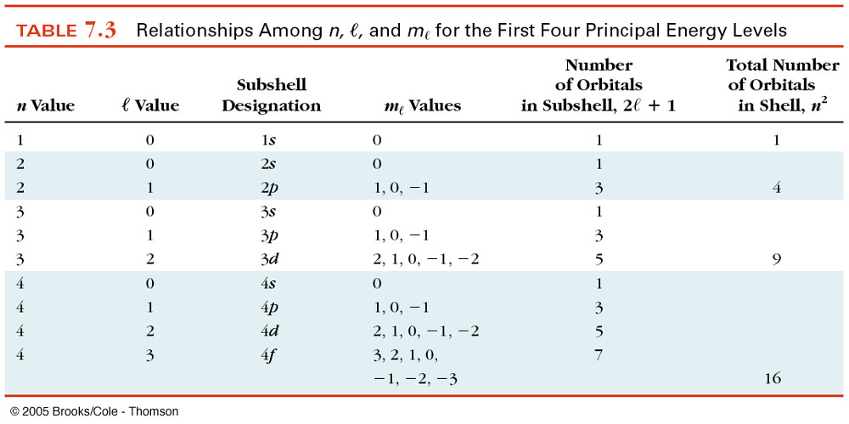

Slide 36
1s
2s 2p
3s 3p 3d
4s 4p 4d 4f
5s 5p 5d 5f
6s 6p 6d 6f
Aufbau Principle: Electrons fill orbitals in
order of increasing energy, 2 electrons per orbital.

Slide 37
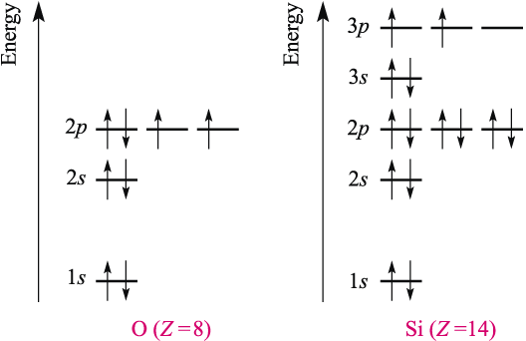
Ground state electronic configurations
4s 3p 3d
n+l 4 4 5
Filling 2 1 3
Degenerate orbitals have equal energies

Slide 39
Electronic Configuration
As atom
33 electons
1s², 2s², 2p⁶, 3s², 3p⁶, 4s², 3d¹⁰, 4p³
or
[Ar] 4s², 3d¹⁰, 4p³
n+l 4 5 5

Slide 41
Exceptions for Electronic Configuration
Cr : [Ar] 4s² 3d⁴
^{Actual}
Cr : [Ar] 4s¹ 3d⁵
Since both s and d close in energy stability favored for ½ filled s

Slide 42
Exceptions
Mo: [Kr] 5s² 4d⁴
^{Actual}
Mo: [Kr] 5s¹ 4d⁵
BUT
Actual for W : [Xe] 6s² 4f¹⁴ 5d⁴
Since both s and d close in energy stability favored for ½ filled s
Same for Au and Ag

Slide 43
⁵⁷La actual [ Xe]⁵⁴ 6S² 5d¹
rule [ Xe]⁵⁴ 6S² 4f¹
_{89Ac} Actual [ Rn] 7S² 6d¹
rule [ Rn] 7S² 5f¹

Slide 44
Z* => effective nuclear charge
Z* = Z - S
S => shielding as defined by Slater’s Rules

Slide 45
Slater's Rules for Calculating Shielding
for [ns, np] e-s, e-s to the right in the modified electronic configuration contribute nothing
2. for [ns, np] e-s, other electrons of same group contribute 0.35 each (except 1s, 0.3)
3. each electron in n - 1 group, contribute 0.85
4. each electron in n - 2 group, contribute 1.0
5. nd & nf group, rules 1 & 2 remain the same, all electrons to the left contribute 1.0
modified electronic configuration
[1s][2s2p][3s3p][3d][4s] etc

Slide 48
Example: for a 3 d electron in Ni atom
Ni :[Ar]4s² 3d⁸
Z*
4s
4s e’s are easier to remove because they are less bonded to the nucleus
4.05
7.55
3d
Ni²⁺ :[Ar]4s⁰ 3d⁸
In general , the “ n+1” S e’s are easier to remove than the nd e’s. Even though they fill first

Slide 50
Examples: for the 4 s electron in Cu atom
[1s²][2s²2p⁶][3s²3p⁶][3d¹⁰][4s¹]
n - 2 group => 10 * 1.0
n - 1 group => 18 * 0.85
n group => 0 * 0.35
(4s) Z* = 29 - ((10 * 1.0) + (18 * 0.85) + (0 * 0.35))
= 29 - 10 - 15.3
= 3.7

Slide 51
Example: for a 3 d electron in Cu atom
[1s²][2s²2p⁶][3s²3p⁶][3d¹⁰][4s¹]
rule 5. group
18 * 1.0
9 other d electrons * 0.35
(3d) Z* = 29 - ((18 * 1.0) + (9 * 0.35))
= 29 - 18 - 3.2
= 7.8

Slide 52
First Ionization Energy (IE₁)
M → M⁺ + e⁻ IE₁ = ΔE
i.e. Mg → Mg⁺ + e⁻ IE₁ = ΔE = 738 kJ/mol
Second Ionization Energy (IE₂)
M⁺ → M²⁺ + e⁻ IE₂ = ΔE
i.e. Mg⁺ → Mg²⁺ + e⁻ IE₂ = ΔE = 1450 kJ/mol
Third Ionization Energy (IE₃)
M²⁺ → M³⁺ + e⁻ IE₃ = ΔE
i.e. Mg²⁺ → Mg³⁺ + e⁻ IE₃ = ΔE = 7734 kJ/mol

Slide 53
Factors Affecting the Ionization Energy
1. Effective Nuclear Charge (Z_{eff})
A larger value of Z_{eff} means that the valence electron will have a greater attraction to the nucleus, increasing the Ionization Energy.
2. Distance from the nucleus (n)
Valence electrons further from the nucleus will have a weaker attraction, decreasing the Ionization Energy.

Slide 54
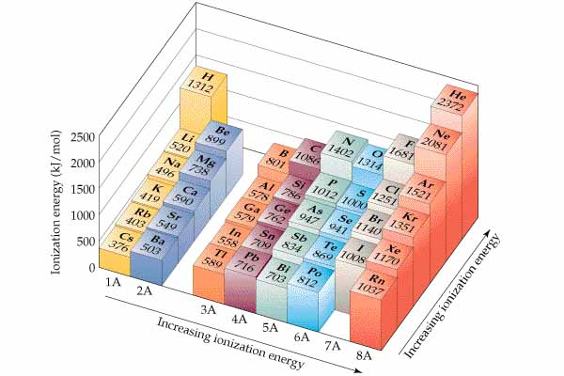
Ionization Energies
-“Z* effect” increases across a period (because e- become more tightly held;
thus z* increases)
-“n effect” increases up a group (because s becomes higher down a group)
Summary: ↑
→
Periodic Table
IE₁ increases
IE₁ increases

Slide 55
Trends in Ionization Energy
Rank the following atoms in the order
of increasing first ionization energy (I₁): P, S, O
P < S < O
Rank the following atoms in the order
of decreasing first ionization energy (I₁): Li, C, Na
C > Li > Na
Which of the following atoms has the largest
first ionization energy (I₁)?: S, Cl, Se, Br
Cl
Which of the following atoms has the smallest
first ionization energy (I₁)?: Na, S, K, Se
K

Slide 56
Electron Affinity (EA)
-Energy released when an electron is added to an atom
A (g) + e- → A - (g) ∆U = -EA
OR
Electron Affinity (EA) Energy required to remove an e- from an anion
A- (g) → A (g) + e- ∆U = EA
same trends as ionization energy, increases from lower left corner to the upper right corner
Trends for EA:
Summary: same as IP ↑
→
Z* = Z- more important in periods
S- more important in groups “n-effect”
metals have low “Ea”
nonmetals have high “Ea”

Slide 57
Electron Affinity
Example: Which has a higher IP?
Ca or Sr?
Ans: Ca (s-effect)
Si or Cl?
Ans: Cl (z-effect)
Explain the following IP trend.
Cl- < Cl < Cl+
349 1251 2300 kJ/mol
easier to remove an e- from an anion than a neutral atom,
and subsequently a cation.

Slide 58
Covalent/Ionic/van der Waals Radii (r)
Across a period, Z ↑ ; therefore e- are drawn to the nucleus, so r ↓ (z-effect).
Down a group, “n” increases, r ↑ (n effect).
←↓r
Example:
rNa > rMg > rAl (across a period, z ↑)
rLi < rNa < rK (down a group, n ↑)
-

Slide 59
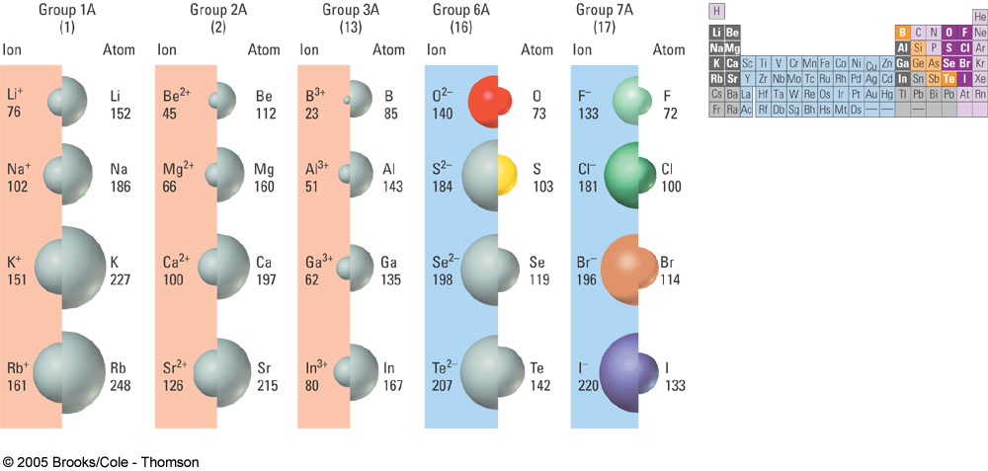
Ionic Radii
The radii of cations are always smaller than the radii of the
neutral atoms.
The radii of anions are always larger than the radii of the
neutral atoms.

Slide 60
Cations
Mg
Mg⁺
Mg ²⁺
(Z=12)
Z_{eff} = 12 - 10 = 2
Less Repulsion
More attraction to nucleus
n=2
Outer Shell
(Z=12)
Z_{eff} = more
Mg > Mg⁺ >> Mg ²⁺
--- cations also have a greater attraction than do anions
r Ti2+ > r Ti3+ > rTi4+
--- greater charge on the +4 leads to stronger attraction of the e-

Slide 61
Anions
Cl
Cl⁻
More Repulsion
Cl⁻ > Cl

Slide 62
Isoelectronic Species
O²⁻
Z=8
F⁻
Z=9
Ne
Z=10
Na⁺
Z=11
Mg²⁺
Z=12
#e⁻=10
#e⁻=10
#e⁻=10
#e⁻=10
#e⁻=10
Attraction to nucleus increases
Size Increases
-Instances where small differences in z
e.g. rO2- > r F- > rNa+ > r Mg 2+
--- # e- same but # p+ increases, which leads to stronger attraction => smaller radius

Slide 63
Which of the following species is the largest?
B B⁺ Al Al⁺
Which of the following species is the smallest?
P P⁻ S S⁻
Which of the following species is the largest?
N⁻ P⁺ P⁻ P

Slide 64
Lanthanide contraction (effect on radii)
main group elements vs. TM’s
Li 2s1 Cu 3d10
Na 3s1 Ag 4d10
K 4s1 Au 4f145d10
Lanthanides fill before d
Ionic radii for group 11 monovalent (+1) ions:
Cu+ 1.13 Å
Ag+ 1.33 Å (increase)
Au+ 1.25 Å (decrease)
Au has 4f e- , which has a stronger attraction to the nucleus. Au fills 4f e- before
d e-. => smaller than expected radii for 3rd row TM.
Example:
Explain why the lanthanide contraction is not a factor in the following:
Sc3+ 0.68 Å
Y3+ 0.88 Å ie normal n-effect
La3+ 1.06 Å
There are no f electrons (Lanthanide contraction starts w/ group 4, not 3)
←↓r

Slide 65
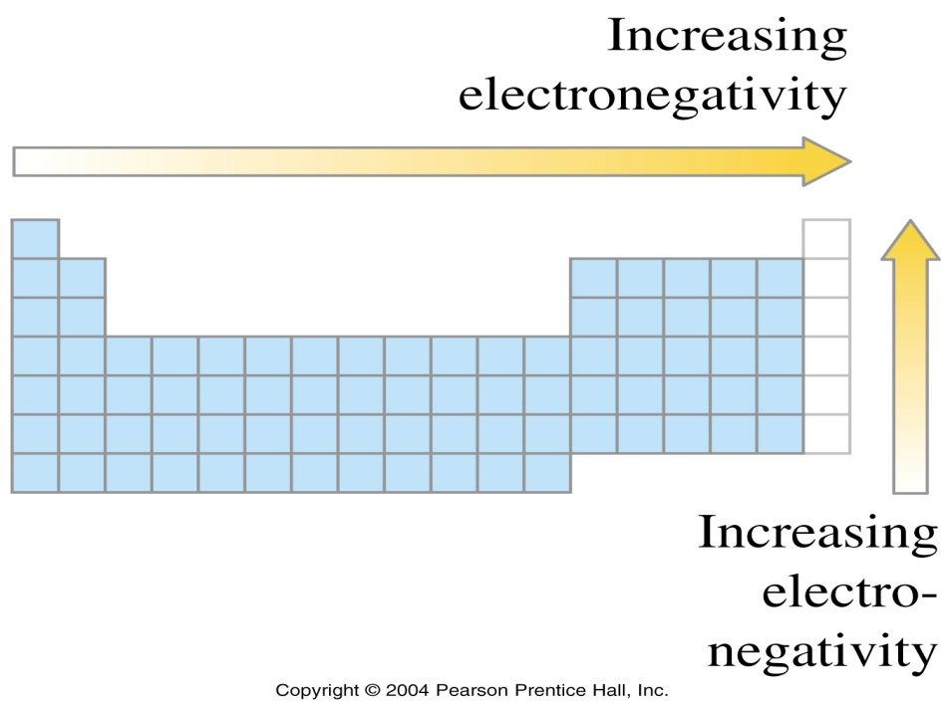
Electronegativity
Electronegativity (EN) is a measure of the ability of an atom to attract its bonding electrons to itself.
EN is related to ionization energy and electron affinity.
The greater the EN of an atom in a molecule, the more strongly the atom attracts the electrons in a covalent bond.
Electronegativity generally increases from left to right within a period, and it generally increases from the bottom to the top within a group.

Slide 66
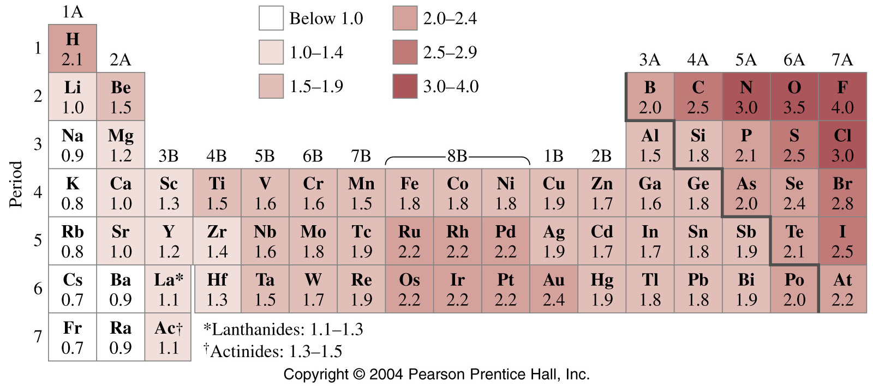
Pauling’s Electronegativities
Linus Pauling developed an arbitrary scale of electronegativities
_{(χ) with values ranging from:}
F: χ=4.0 (most electronegative)
_{to}
Fr: χ=0.7 (least electronegative)
It would be a good idea to remember the four elements of highest electronegativity: N, O, F, Cl.

Slide 67
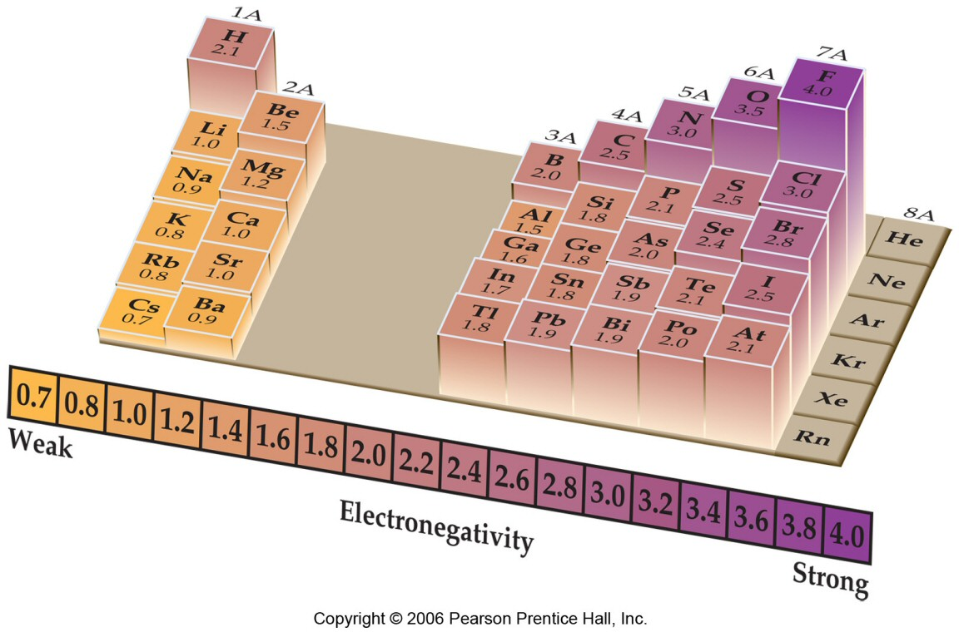
Electronegativity

Slide 68
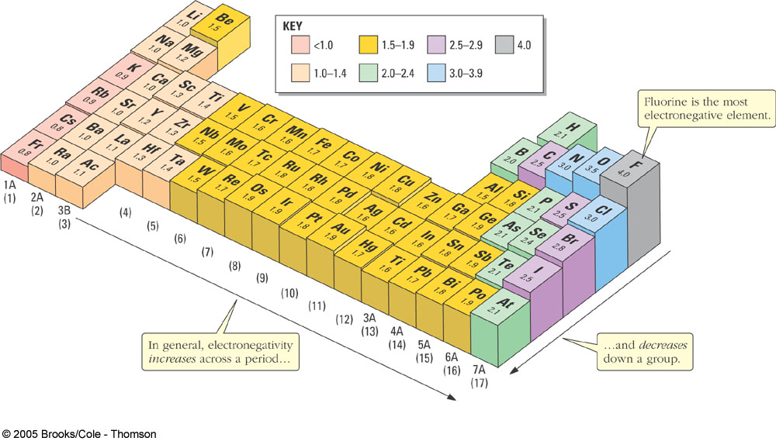
Electronegativity
χ Increases
χ Increases

Slide 69
Electronegativity
(1) In a bond between two atoms, the atom with the higher
electronegativity (χ) is partially negative (δ-).
(2) The larger the difference in electronegativities (Δχ), the
more polar the bond.
Which of the following bonds are the (a) most polar, and (b) least polar.
In each case, indicate the positive and negative ends of the bond.
Atom χ
F 4.0
O 3.5
N 3.0
C 2.5
H 2.1
Li 1.0
δ+ δ-
δ- δ+
δ- δ+
δ+ δ-
C-O
N-C
C-H
Li-F
Δχ=3.5-2.5
=1.0
Δχ=3.0-2.5
=0.5
Δχ=2.5-2.1
=0.4
Δχ=4.0-1.0
=3.0
Least Polar
Most Polar
(Ionic)

Slide 71
Electronic Configuration
negative ions
add electron(s), 1 electron for each negative charge
S⁻² ion
(16 + 2) electrons
1s², 2s², 2p⁶, 3s², 3p⁶

Slide 72
Electronic Configuration
positive ions
remove electron(s), 1 electron for each positive charge
Mg⁺² ion
(12-2) electrons
1s², 2s², 2p⁶
Fe atom Fe⁺² ion
(26) electrons (26-2) electrons
[Ar]4s²3d⁶ [Ar]4s⁰3d⁶

Slide 73
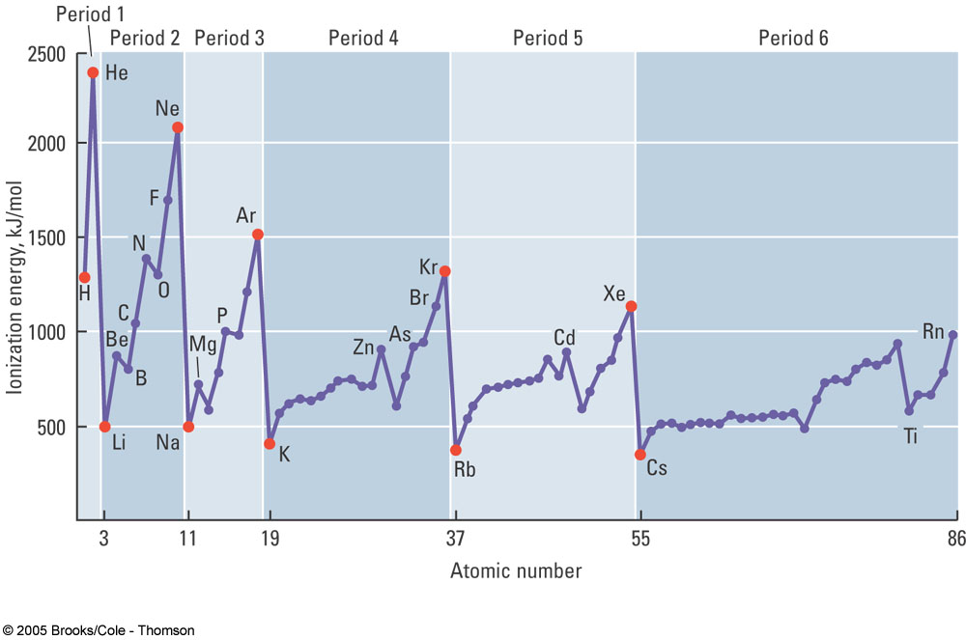

Slide 74
Electronegativity
Pauling Scale
relative attraction of an atom for electrons, its own and those of other atoms
same trends as ionization energy, increases from lower left corner to the upper right corner
fluorine: E.N. = X_{P} = 4.0
based on the energetics of bond formation

Slide 75
Effective Nuclear Charge

Slide 76
Electron Affinity
Recall that IP => A (g) → A+(g) + e- 1st IP
A+ (g) → A 2+ (g) + e- 2nd IP
A2+ (g) → A 3+ (g) + e- 3rd IP
So
An (g) → A n+1 (g) + e- (n+1)IP
EA is the 0th IP, therefore EA is really an IP, so they follow the same trend.
EA values are generally much smaller than IP,
because it’s easier to remove an e- from an anion than from a neutral atom.
Summary for IP & EA: ↑ →
Z* = Z- more important in periods
S- more important in groups “n-effect”

