Slide 1

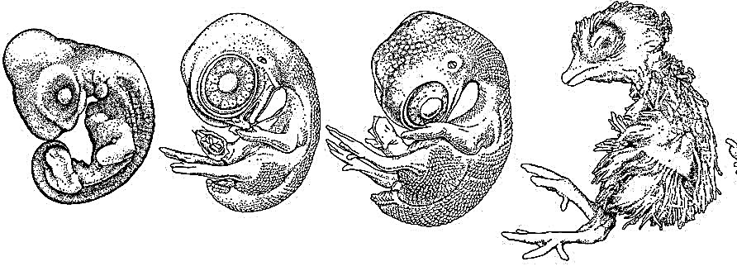
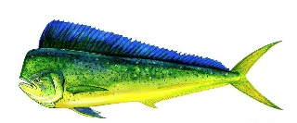
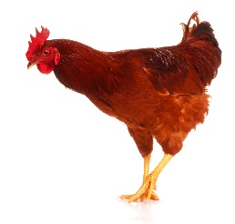
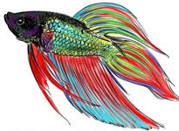
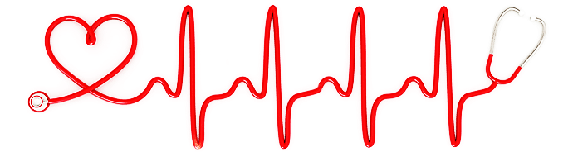
Environment
- oxygen
- temperature
- toxicants
- pH
Our
Lab
Physiology
Development
- metabolism
- regulation
- locomotion
- reproduction
- plasticity
- self-repair
- epigenetic
inheritance

